Slide 1

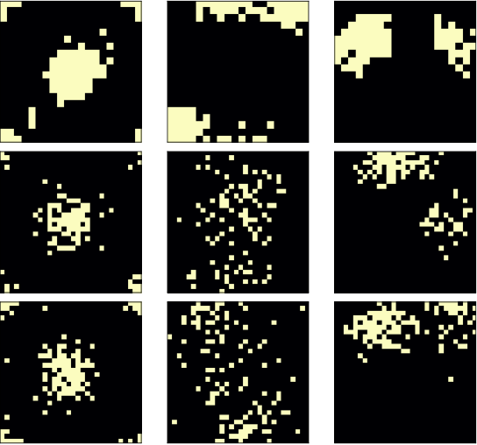
第三十五屆南區統計研討會 暨2026年中華機率統計學會年會及學術研討會
國立成功大學, 2026/06/25-26
S-IGTD:
Supervised Tabular-to-Image Topology Learning via Between-group Correlation for Multiclass Classification of High-dimensional Biological Data
(S-IGTD: Supervised Image Generator for Tabular Data for CNN-based Deep Learning Multiclass Classification)
Han-Ming Wu (吳漢銘)
Department of Statistics
National Chengchi University
Taiwan
(國立政治大學 統計學系)

Slide 2
Outline
Introduction: Convolutional Neural Network (CNN)
Background: Literature Review
  Tabular-to-Image Methods for Deep Learning
  Image Generator for Tabular Data (IGTD)
  Motivation: Supervised Topology for Biological Data Tables
Method: Supervised IGTD via Between-class Correlation
Theoretical Properties
Simulation Studies
Real Data Analysis
Concluding Remarks
Notes:
電影《赤壁》中，諸葛亮說："什麼都略懂一點，生活才多彩一點。
諸葛亮說周瑜的陣過時了，周瑜問：「你也懂陣法？」他說：「略懂。」
諸葛亮要給馬接生。周瑜問:「這個你也懂？」他說:「略懂，略懂。」而後，為母馬接了生。
當周瑜問他是否懂琴，他也是說了句「略懂」。合琴中，琴聲如同有生命一般，讓人讚不絕口。
誠然，我們只有什麼都略懂一點，我們的人生才會更加豐富多彩，才能更好的應對生活的風浪。
原文網址：https://kknews.cc/essay/r3ejo84.html

Slide 3
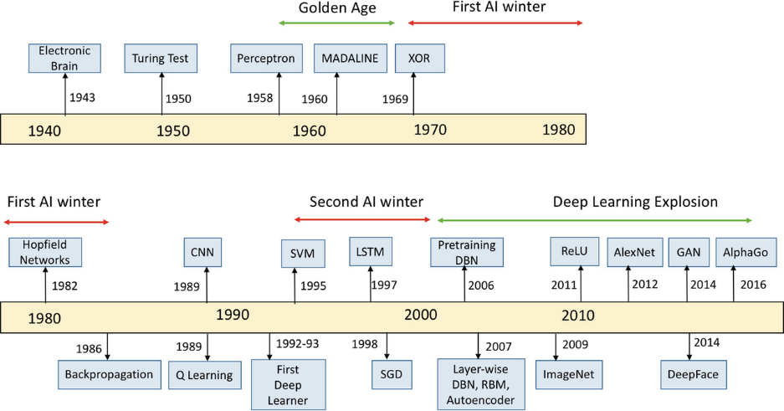
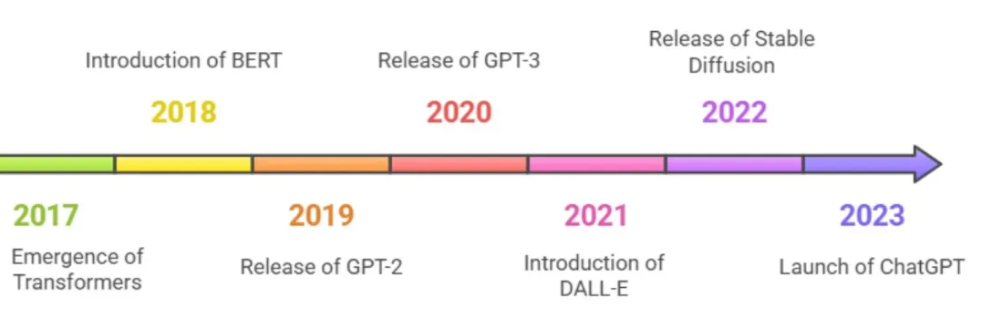
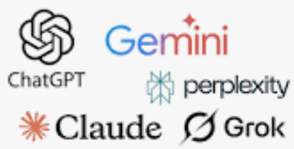
Deep Learning Algorithms and Their Applications
LeCun, Y., Bottou, L., Bengio, Y., & Haffner, P. (2002). Gradient-based learning applied to document recognition. Proceedings of the IEEE, 86(11), 2278-2324. (#cites: 86446)
Krizhevsky, A., Sutskever, I., & Hinton, G. E. (2012). ImageNet classification with deep convolutional neural networks. Advances in neural information processing systems, 25. (#cites: 155382)
https://github.com/gopala-kr/summary/blob/master/20.md
Strengths:
Exceptional at image data processing: Achieves state-of-the-art classification performance.
High feature extraction capability: Automatically learns hierarchical patterns (edges → textures → objects).
Weaknesses:
Low interpretability: Acts as a "black box" (difficult to trace decision logic).
No native tabular data support: Requires preprocessing (e.g., tabular-to-image conversion) for traditional datasets.

Slide 4
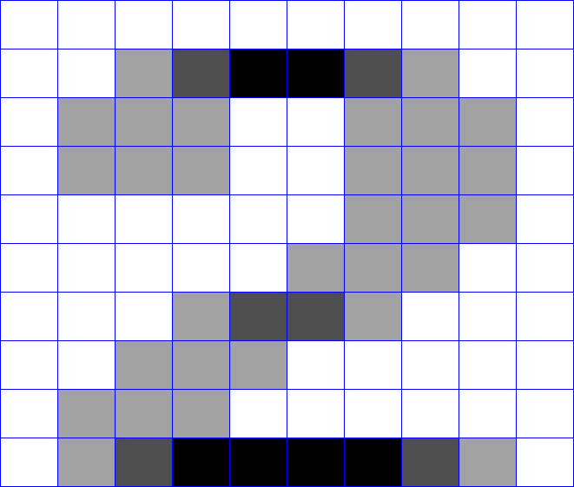


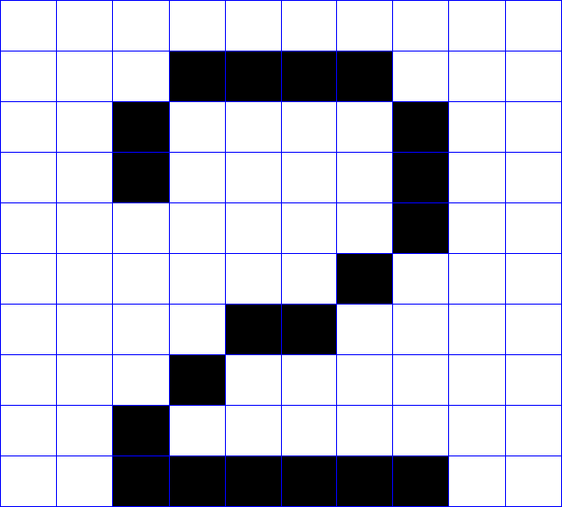
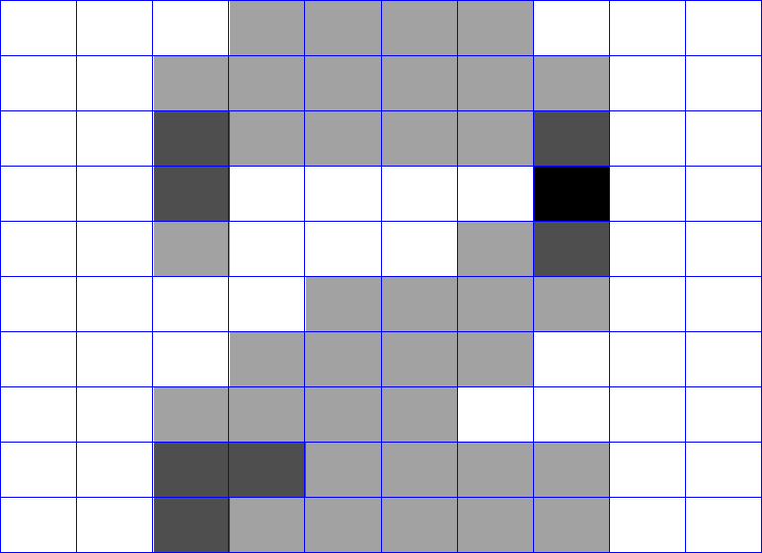


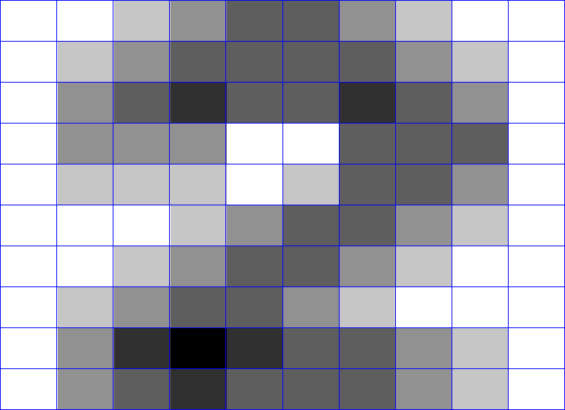
Convolutional Neural Networks (CNNs)
Feature map
Input
layer
Hidden
layer
Output
layer
kernel
Input image
0
1
2
.
.
.
9
...
Convoluation
Pooling
Flattern
Fully connection

Slide 5


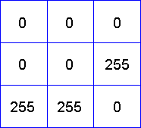
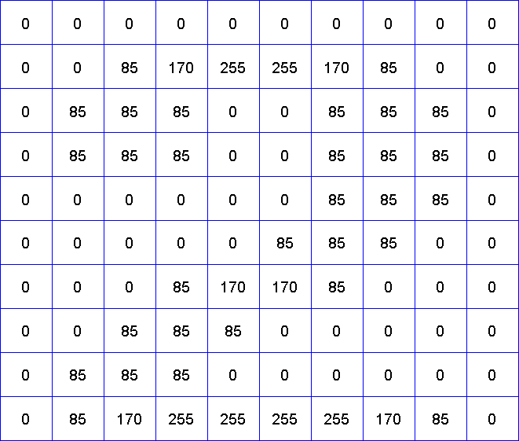
Convolution
Stride:
kernel moving size
Data matrix
(image grayscale)
8bit
(filter)
Convolution
kernel
Raw image
10x10 pixels
0 | 0 | 0
1 | 1 | 1
0 | 0 | 0
convolve {imager},
Boundary condition:
Dirichlet (T), Neumann (F)
$\frac{1}{3}$ $×$
$$×$$
= $85$
Feature map
Normalization
factor
zero padding method:
input image + 0，and then Convolution
image size=10x10

Slide 6
Pooling
0 | 170 | 255 | 170 | 0
85 | 85 | 0 | 85 | 85
0 | 0 | 85 | 85 | 85
0 | 85 | 170 | 85 | 0
85 | 255 | 255 | 255 | 85
max pooling operation with 2x2 filter
stride value 2
output:
5x5 (size-reduced)
pooled image
data matrix
input:
10x10 image
data matrix
Understanding Max-Pooling of Image Data with R
https://www.datatechnotes.com/2018/11/understanding-max-pooling-image-data.html

Slide 7
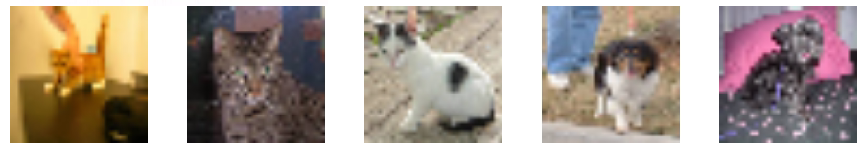
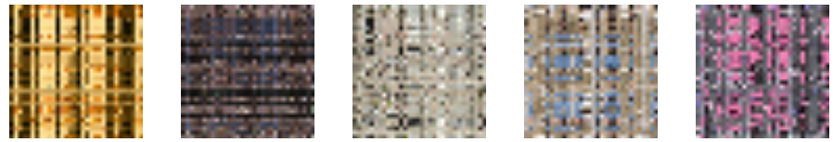
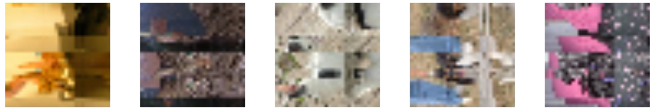
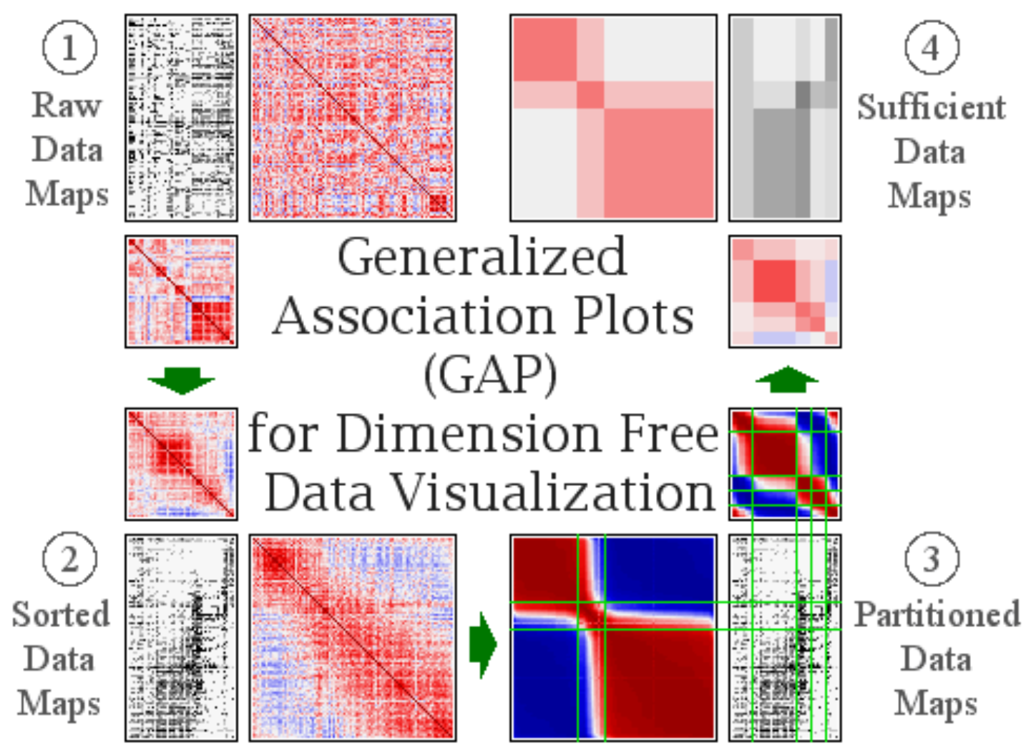
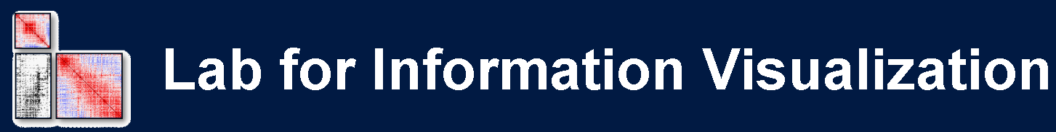


Motivation: Tabular Data to Images
CNN
Cat, Dog
Random permutation of rows and columns of an image
CNN
obtain lower accuracy
Implication:
Meaningful permutation of rows and columns of an image

Slide 8
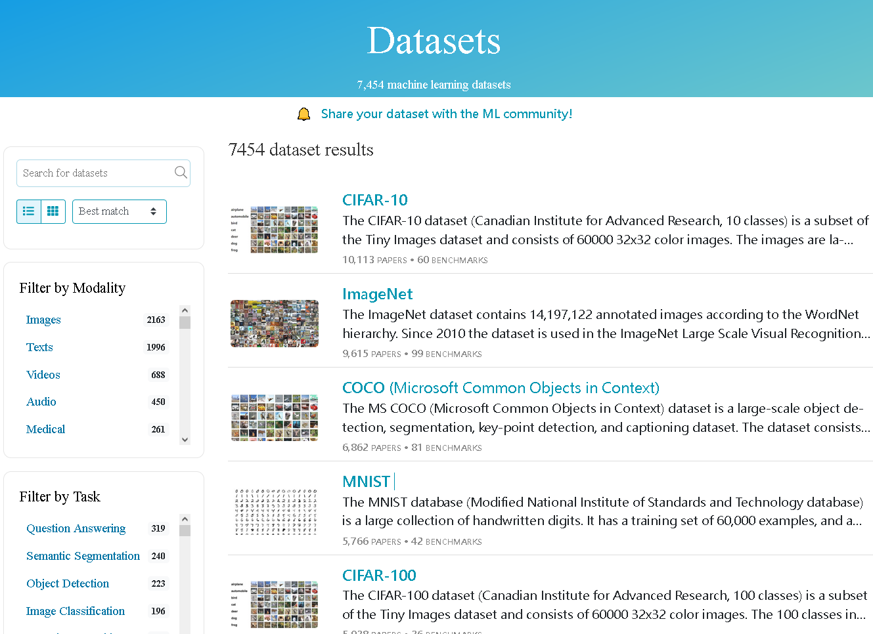
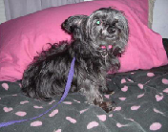
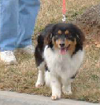
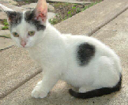
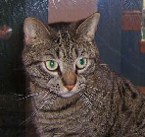
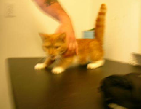
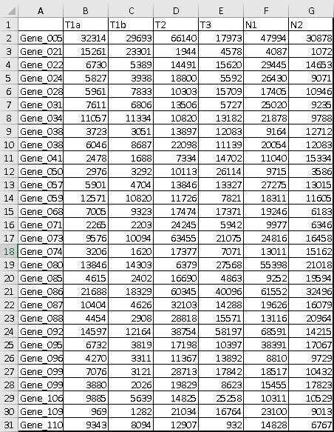



Objectives:
Classification Task based on CNN/DL
Scenario (A): Input data are images.
Unstructured Data
CNN/DL
Cat, Dog
https://paperswithcode.com/datasets
Scenario (B): Input data is tabular.
Structured Data
pseudo
images
n samples
by p variables
Convert
CNN/DL ?

Slide 9
Literature Review (1):
Tabular Data to Images Data + CNN
S. Choi, C. Fang, D. Haddad, M. Kim (2022). Predictive modeling of charge levels for battery electric vehicles using CNN EfficientNet and IGTD algorithm. ArXiv, 2206.03612.
A. Taheri, H. Ebrahimnezhad, M.H. Sedaaghi (2022). Prediction of the critical temperature of superconducting materials using image regression and ensemble deep learning. Materials Today Communications, 33, 104743.
Tang, H., Yu, X., Liu, R., Zeng, T. (2022). Vec2image: an explainable artificial intelligence model for the feature representation and classification of high-dimensional biological data by vector-to-image conversion. Briefings in Bioinformatics, 23(2), bbab584.
Levin, R., Cherepanova, V., Schwarzschild, A., Bansal, A., Bruss, C. B., Goldstein, T., Wilson, A. G., Goldblum, M. (2022). Transfer learning with deep tabular models. Technical Report arXiv:2206.15306, arXiv.
Cappuzzo, R. (2022). Deep learning models for tabular data curation (Doctoral dissertation, Sorbonne Université).
Jain, V., Goel, M., Shah, K. (2022). Deep learning on small tabular dataset: using transfer learning and image classification. In A. Dev, S.S. Agrawal, A. Sharma (Eds.), Artificial Intelligence and Speech Technology. AIST 2021. Communications in Computer and Information Science, vol 1546 (pp. 555-568). Springer, Cham.
Lee, E., Nam, M., Lee, H. (2022). Tab2Vox: CNN-based multivariate multilevel demand forecasting framework by tabular-to-voxel image conversion. MDPI Sustainability, 14, 11745.
Zhu, Y., Brettin, T., Xia, F. et al. (2021). Converting tabular data into images for deep learning with convolutional neural networks. Scientific Reports, 11, 11325. (Citations: 323)
Borisov, V., Leemann, T., Sessler, K., Haug, J., Pawelczyk, M., & Kasneci, G. (2021). Deep neural networks and tabular data: a survey. ArXiv, abs/2110.01889.
Bazgir, O., Zhang, R., Dhruba, S.R. et al. (2020). Representation of features as images with neighborhood dependencies for compatibility with convolutional neural networks. Nature Communications, 11, 4391. (Citations: 180)
Sharma, A., Vans, E., Shigemizu, D. et al. (2019). DeepInsight: A methodology to transform a non-image data to an image for convolution neural network architecture. Scientific Reports, 9, 11399.
Ma, S., Zhang, Z. (2018). OmicsMapNet: Transforming omics data to take advantage of deep convolutional neural network for discovery. ArXiv, 1804.05283.
A Short Chronology Of Deep Learning For Tabular Data Jul 24, 2022 by Sebastian Raschka, https://sebastianraschka.com/blog/2022/deep-learning-for-tabular-data.html
Deep Neural Networks and Tabular Data Survey Review, June 20, 2022 by Egli P., Business Development Analyst at Electi Consulting, https://www.linkedin.com/pulse/deep-neural-networks-tabular-data-survey-review-egli-papadopoulou?trk=pulse-article

Slide 10
Literature Review (2):
Tabular Data to Images Data + CNN
Ye, H. J., Liu, S. Y., Cai, H. R., Zhou, Q. L., & Zhan, D. C. (2024). A closer look at deep learning methods on tabular datasets. arXiv preprint arXiv:2407.00956.
Tang, X., Prodduturi, N., Thompson, K. J., Weinshilboum, R. M., O'Sullivan, C. C., Boughey, J. C., ... & Kalari, K. R. (2024). OmicsFootPrint: a framework to integrate and interpret multi-omics data using circular images and deep neural networks. BioRxiv.
Sha, Y., Meng, W., Luo, G., Zhai, X., Tong, H. H., Wang, Y., & Li, K. (2024). MetDIT: Transforming and Analyzing Clinical Metabolomics Data with Convolutional Neural Networks. Analytical Chemistry.
Matsuda, T., Uchida, K., Saito, S., & Shirakawa, S. (2024). HACNet: End-to-end learning of interpretable table-to-image converter and convolutional neural network. Knowledge-Based Systems, 284, 111293.
Lee, S. E., & Lee, S. C. (2023). TablEye: Seeing Small Tables through the Lens of Images. ArXiv, 2307.02491.
Castillo-Cara, M., Talla-Chumpitaz, R., García-Castro, R., & Orozco-Barbosa, L. (2023). TINTO: Converting Tidy Data into image for classification with 2-Dimensional Convolutional Neural Networks. SoftwareX, 22, 101391.
Randive, K. D., & Ramasundaram, M. (2023). MWCapsNet: A novel Multi-level Wavelet Capsule Network for insider threat detection using image representations. Neurocomputing, 553, 126588.
Nazarri, M. N. A. A., Yusof, M. H. M., & Almohammedi, A. A. (2023). Generating Network Intrusion Image through IGTD Algorithm for CNN Classification. 2023 3rd International Conference on Computing and Information Technology (ICCIT), 172-177.
Hosseini, M., & Chitsaz, I. (2023). Knock probability determination employing convolutional neural network and IGTD algorithm. Energy, 284, 129282.
Fleischanderl, S. (2023). Time Series Transformation into Images for Production State Recognition (Master's thesis, JOHANNES KEPLER UNIVERSITY LINZ).
Briner, N., Cullen, D., Halladay, J., Miller, D., Primeau, R., Avila, A., ... & Doleck, T. (2023). Tabular-to-Image Transformations for the Classification of Anonymous Network Traffic using Deep Residual Networks. IEEE Access, 11, 113100-113113.
Bazgir, O., & Lu, J. (2023). REFINED-CNN framework for survival prediction with high-dimensional features. Iscience, 26(9).
Neto, L. M., & Endo, P. T. (2023). The use of Convolutional Neural Network to classify Congenital Syphilis with image representations of tabular data.

Slide 11
Literature Review (3):
Tabular Data to Images Data + CNN
Zhang, F., Li, Z., Zhou, G., Wang, J., Lu, J., & Zhang, K. (2026, January). Visual Table Understanding: Methods, Challenges and Future Directions. In 2026 5th International Symposium on Computer Applications and Information Technology (ISCAIT) (pp. 42-50). IEEE.
Jiang, J. P., Liu, S. Y., Cai, H. R., Zhou, Q. L., & Ye, H. J. (2026). Representation learning for tabular data: A comprehensive survey. IEEE Transactions on Pattern Analysis and Machine Intelligence. vol. 48, no. 6, pp. 6488-6508
Cai, H., & Ye, H. J. (2026). Feature-aware modulation for learning from temporal tabular data. Advances in Neural Information Processing Systems, 38, 151014-151037.
Yu, K. Y., Zhou, Z., Tian, S. Y., Yang, X. W., Jia, Z. Y., Yang, M., ... & Li, Y. F. (2026). Thinking with Tables: Enhancing Multi-Modal Tabular Understanding via Neuro-Symbolic Reasoning. arXiv preprint arXiv:2603.24004.
Cai, H. R., & Ye, H. J. (2025). Understanding the limits of deep tabular methods with temporal shift. arXiv preprint arXiv:2502.20260.
Liu, J., González-Fernández, D., Castillo-Cara, M., & García-Castro, R. (2025). TINTOlib: A Python library for transforming tabular data into synthetic images for deep neural networks. SoftwareX, 32, 102444.
Escalera González, F. (2025). PermGrad: Interpretable Hybrid Neural Networks with Synthetic Images for Tabular Data.
Liu, J., Castillo-Cara, M., & García-Castro, R. (2025). A comprehensive benchmark of spatial encoding methods for tabular data with deep neural networks. Information Fusion, 104088.
Continuous
Response
Class labels
?
Structured data
Pseudo
images
n samples
by p variables
X
Convert
CNN/DL
y_{c}
y_{d}
+
Regression
Classification

Slide 12
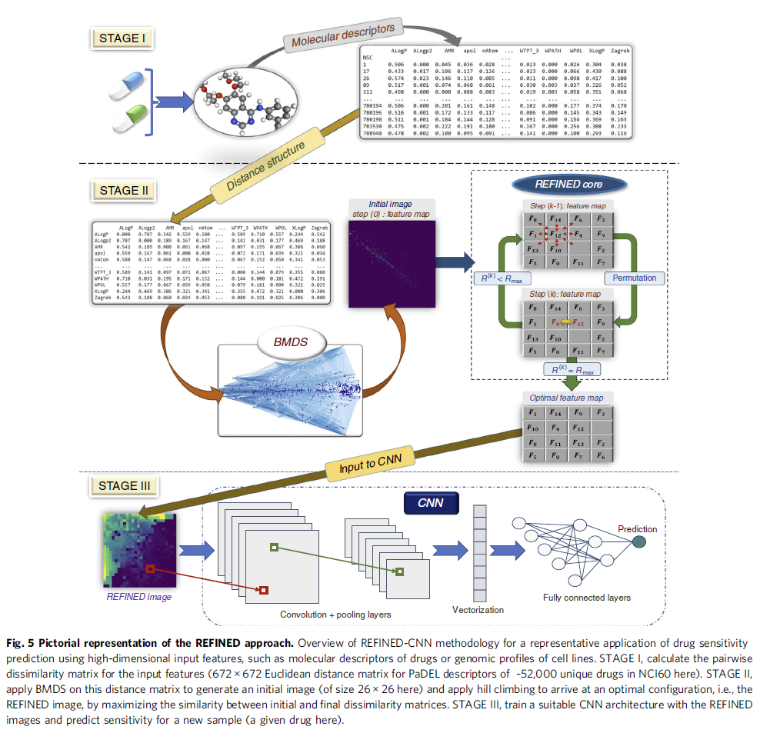
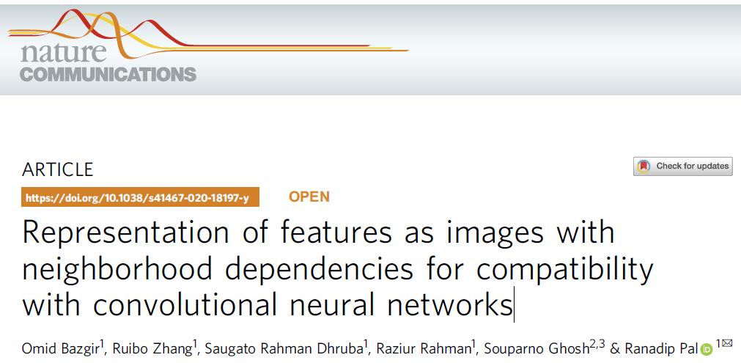
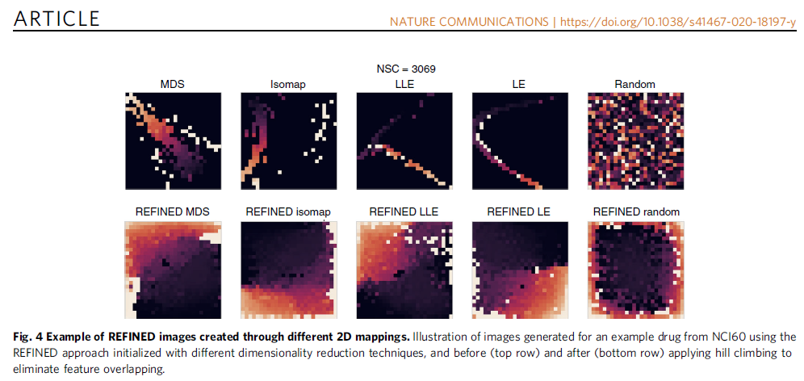
Literature Review:
REFINED-CNN (Projection-based)
Bazgir, O., Zhang, R., Dhruba, S.R. et al., 2020, Representation of features as images with neighborhood dependencies for compatibility with convolutional neural networks. Nat Commun 11, 4391. (#cites: 180)

Slide 13
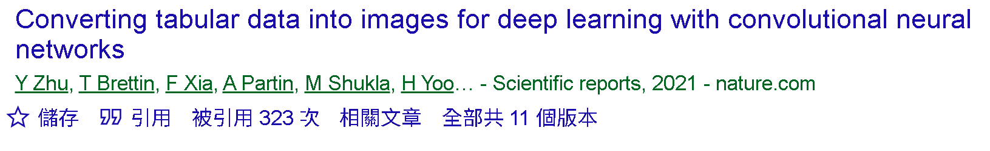
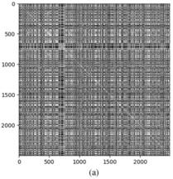
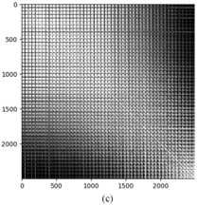
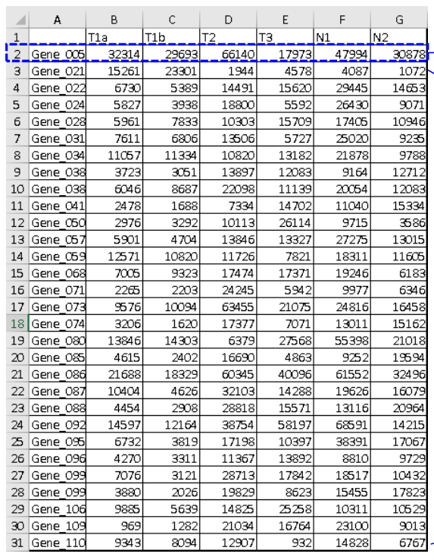
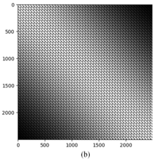
IGTD Algorithm (1)
Rank matrix of
Euclidean distances (R)
(1)
T1a T1b T2 T3 N1 N2
T1a
T1b
T2
T3
N1
N2
(3)
(2)
Output Pseudo Image Grid
(2, 1) | (2, 2) | (2, 3)
(1, 1) | (1, 2) | (1, 3)
Optimize
feature
swap
N1 T1a T1b T2 N2 T3
N1
T1a
T1b
T2
N2
T3
Rank matrix of Euclidean distances (Q) between all pairs of pixels calculated based on their coordinates in a K by K image
Distance
between
variables:
ED, RD, GD,
JD, WD
Tabular Data:
n samples (rows),
p variables (columns)
(4)
Optimal Rank matrix of
Euclidean distances (R')
Backward to determine variable positions in the image grid.
(1, 1) (1, 2) . . . . . . . . (2, 3)
N1 | T1a | T1b
T2 | N2 | T3
Generate an image for each subject by mapping their data to these determined positions.

Slide 14
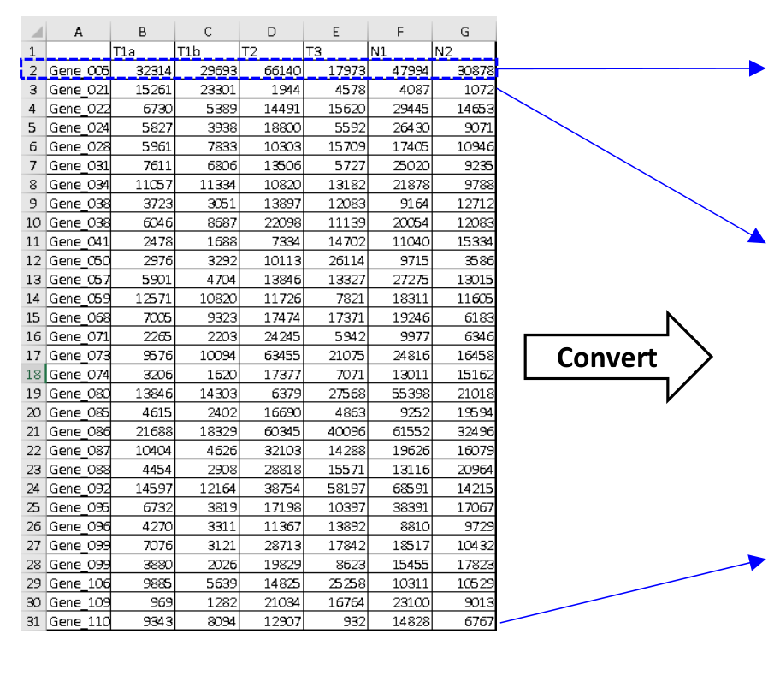
IGTD Algorithm (2)
(5)
pseudo images
N1 | T1a | T1b
T2 | N2 | T3
Tabular Data:
n samples (rows), p variables (columns)
47994 | 32314 | 29693
66140 | 30878 | 17973
CNN/DL
4078 | 15261 | 23301
1944 | 1072 | 17973
。
。
。
14828 | 9343 | 8094
12907 | 6767 | 932
Validity Indices

Slide 15
Applications and Extensions of IGTD
Biomedical/Bioinformatics：Gene Expression Data
Zhu, Y., Brettin, T., Xia, F., Partin, A., Shukla, M., Yoo, H., ... & Stevens, R. L. (2021). Converting tabular data into images for deep learning with convolutional neural networks. Scientific Reports, 11(1), 11325.
Information Security: Network Traffic Data
Nazarri, M. N. A. A., Yusof, M. H. M., & Almohammedi, A. A. (2023). Generating network intrusion image through IGTD algorithm for CNN classification. In 2023 3rd International Conference on Computing and Information Technology (ICCIT) (pp. 172–177). IEEE.
Industry: Quality Management Data
Hosseini, M., & Chitsaz, I. (2023). Knock probability determination employing convolutional neural network and IGTD algorithm. Energy, 284, 129282.
Low-dimensional Tabular Data to Images
Gómez-Martínez, V., Lara-Abelenda, F. J., Peiro-Corbacho, P., Chushig-Muzo, D., Granja, C., & Soguero-Ruiz, C. (2024). LM-IGTD: A 2D image generator for low-dimensional and mixedtype tabular data to leverage the potential of convolutional neural networks. arXiv preprint arXiv:2406.14566.
Time series Data to Images
Karami, H., Hartley, M. A., Atienza, D., & Ionescu, A. (2025). Timehr: Image-based time series generation for electronic health records. IEEE Journal of Biomedical and Health Informatics.

Slide 16
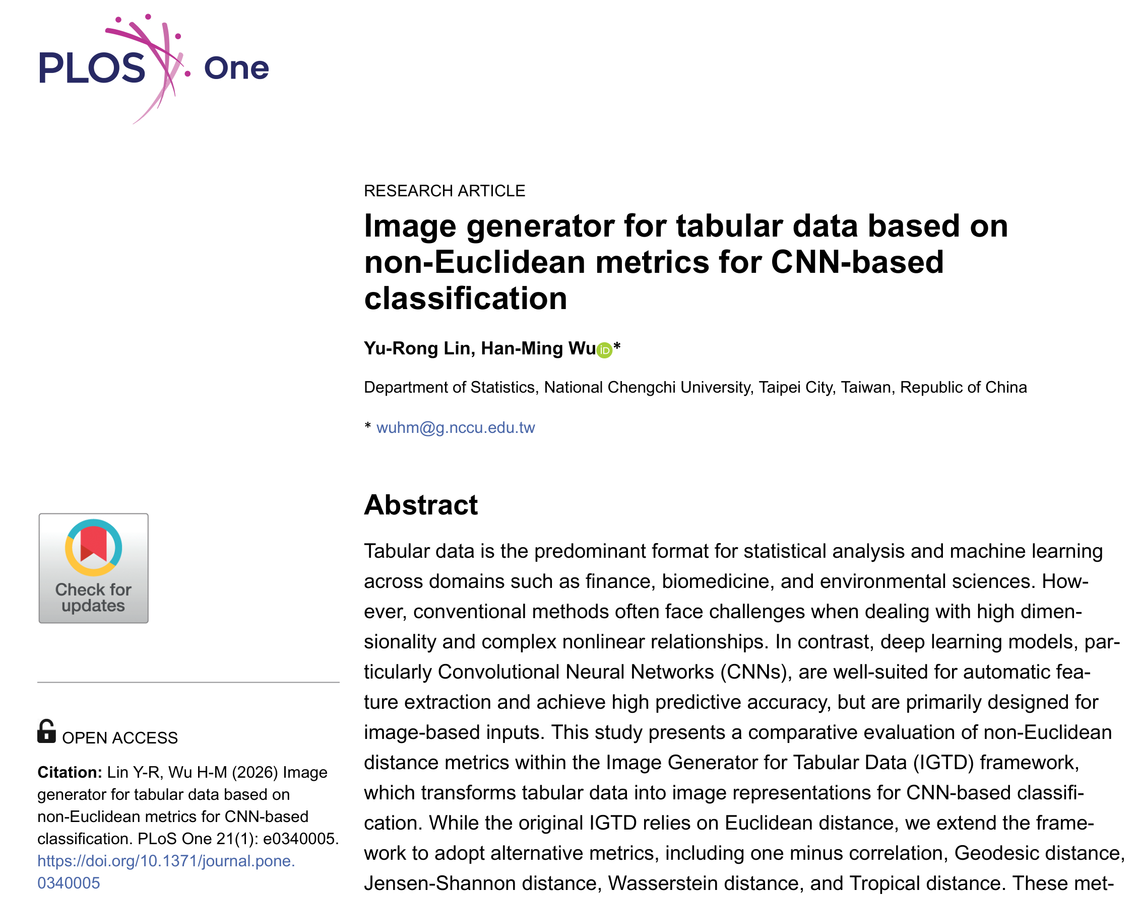
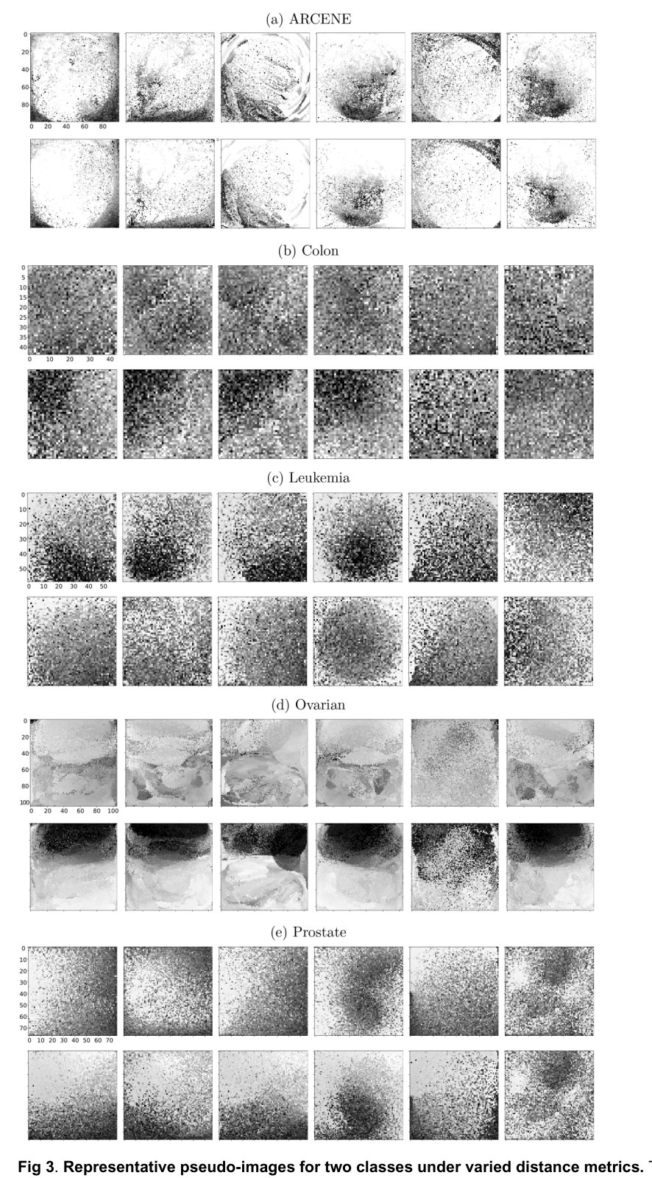
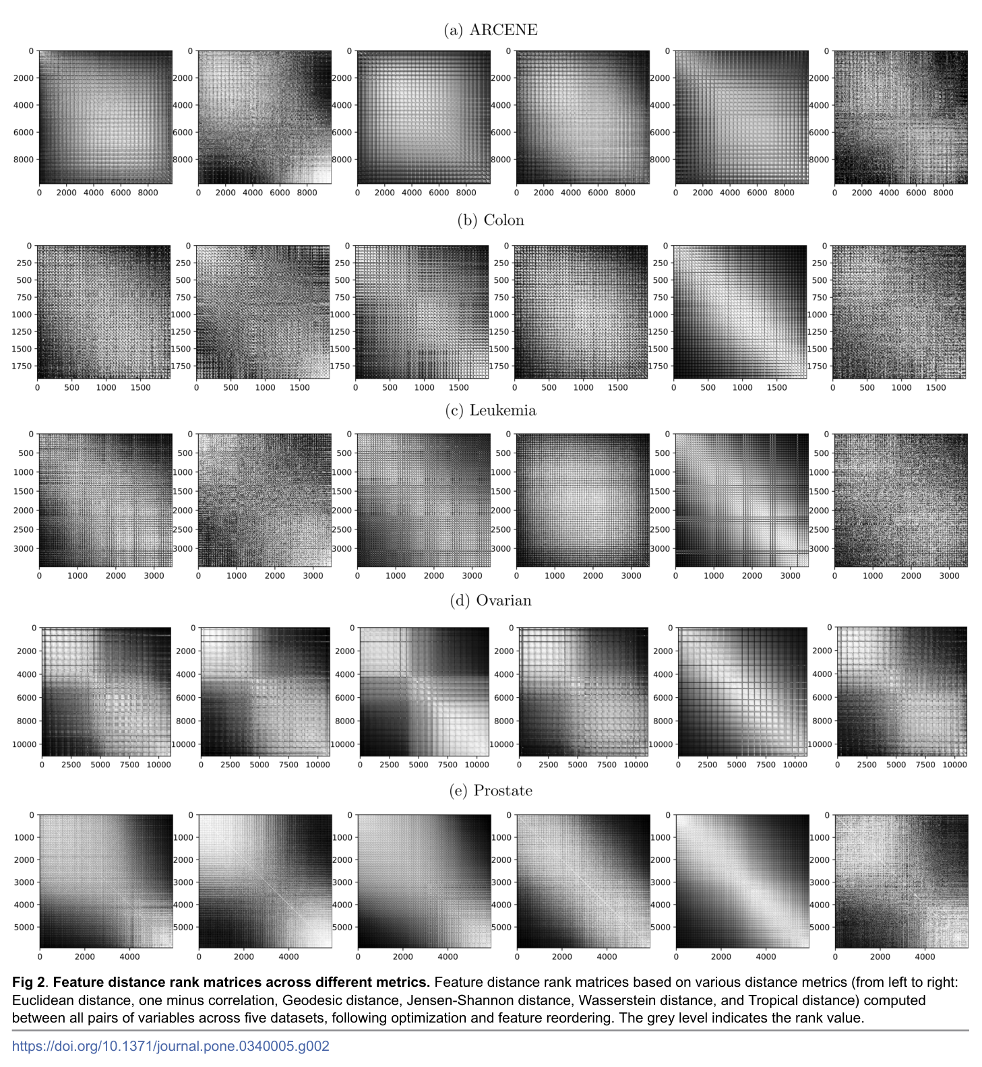
IGTD based on non-Euclidean distance:
1-Correlation (RD), Geodesic distance (GD), Jensen-Shannon distance (JD)
Wasserstein distance (WD), Tropical Distance (TD)
Notes:
電影《赤壁》中，諸葛亮說："什麼都略懂一點，生活才多彩一點。
諸葛亮說周瑜的陣過時了，周瑜問：「你也懂陣法？」他說：「略懂。」
諸葛亮要給馬接生。周瑜問:「這個你也懂？」他說:「略懂，略懂。」而後，為母馬接了生。
當周瑜問他是否懂琴，他也是說了句「略懂」。合琴中，琴聲如同有生命一般，讓人讚不絕口。
誠然，我們只有什麼都略懂一點，我們的人生才會更加豐富多彩，才能更好的應對生活的風浪。
原文網址：https://kknews.cc/essay/r3ejo84.html

Slide 17
Gap in the literature
Projection-based generators are flexible but usually do not optimize class-supervised local topology.
S-IGTD fills this gap by putting class supervision into the pairwise distance matrix used by the topology optimizer.
The scientific question is not only whether a CNN can classify, but whether the constructed topology places class-related features locally.
This design is particularly relevant for multiclass biological classification, where coordinated class-centroid profiles are scientifically meaningful.
小細胞肺癌 (SCLC) | 非小細胞肺癌(NSCLC): 包括腺癌(adenocarcinoma)、鱗狀細胞癌(squamous cell carcinoma, SCC)、大細胞癌(large-cell lung cancer, LCLC)。

Slide 18
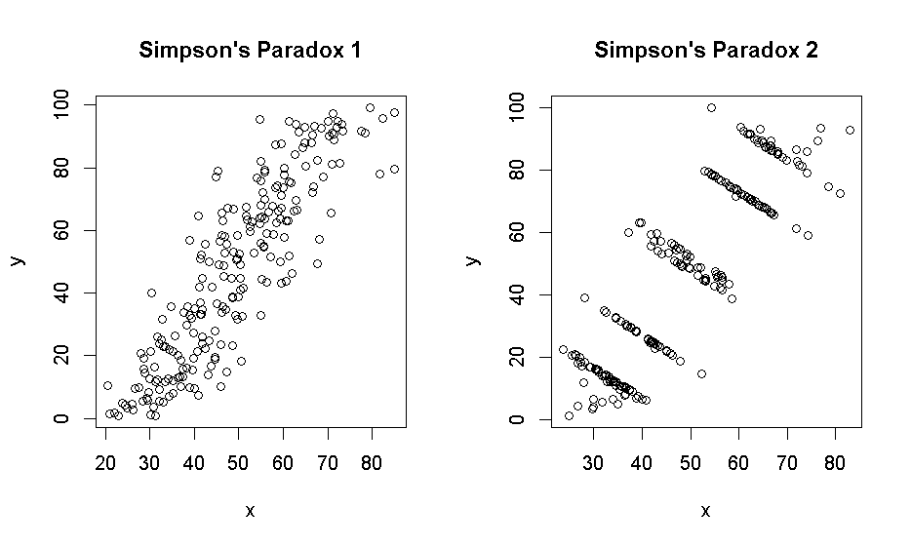
Biological failure mode of unsupervised topology
In biological data, large total correlations can reflect nuisance processes: housekeeping genes, metabolic background, sample quality, batch effects, or within-class variation.
Class-discriminative signal
may instead lie in coordinated
differences among class centroids.
If the layout follows nuisance correlation, local CNN neighborhoods may be spent on label-irrelevant structure while class-informative features are spatially scattered.
This motivates replacing total-correlation topology with between-class topology.
Age 60~70
Cholesterol
Age 50~60
Age 40~50
Exercise volume

Slide 19



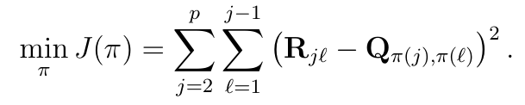
Problem formulation and IGTD objective

Slide 20

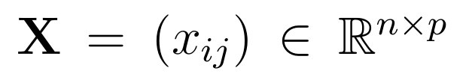
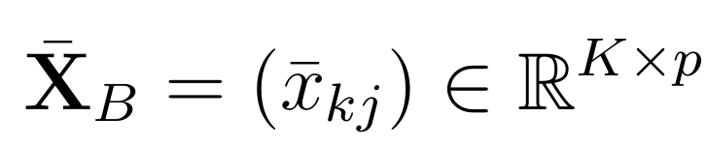
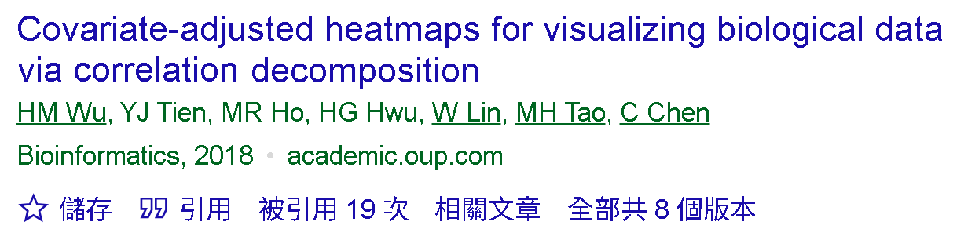
Method: class-centroid matrix
The supervised IGTD (S-IGTD)
Within and Between Analysis (WABA decomposition) (Dansereau et al., 1984).
Continuous
Response
Class labels
Structured data
+
n samples
by p variables
X
y_{c}
y_{d}
Regression
Classification

Slide 21
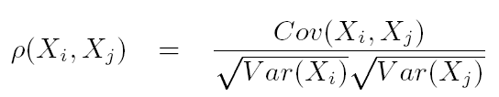
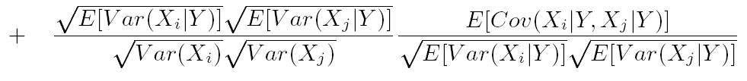



Correlation Decomposition
Between-group correlation
Between-eta
correlation
Within-eta
correlation
Within-group correlation

Slide 22
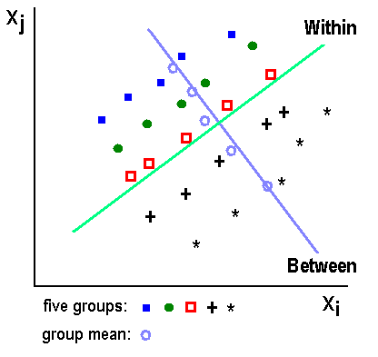




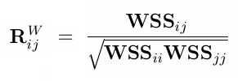
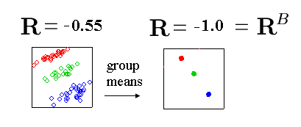
Within And Between Analysis
Notes:
WABA I: Assessment of Variation: eta
Each variable is assessed to determine whether the variable varies
between group (suggesting within-group homogeneity).
within groups (suggesting within-group heterogeneity).
both between and within groups (suggesting individual differences rather than within-group homogeneity or heterogeneity).

Slide 23


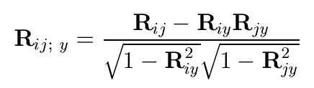
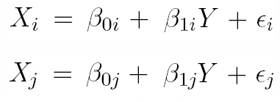
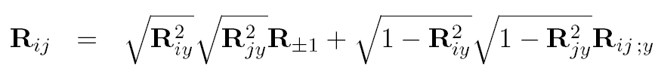


Continuous Case: Partial Correlations
Conditional correlation is equivalent to partial correlation under some assumptions (Kurowicka and Cooke, 2000).

Slide 24
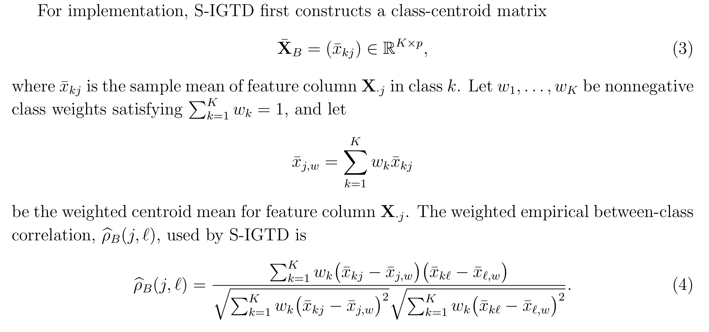
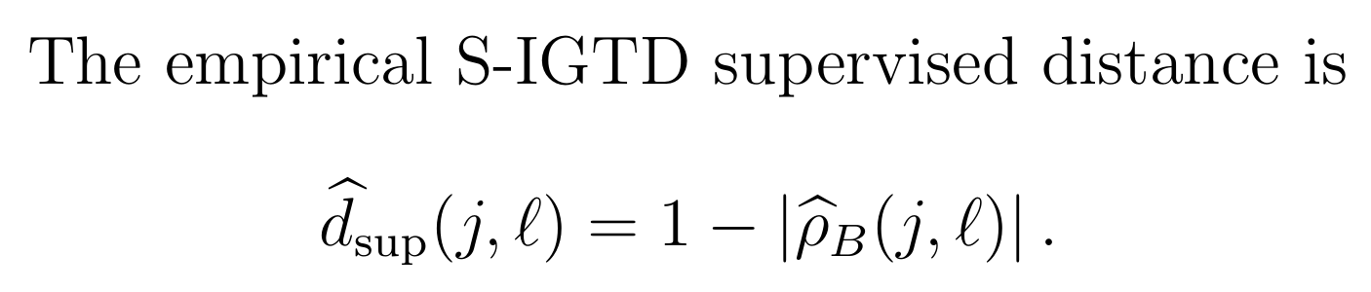
Between-class correlation and
S-IGTD supervised distance

Slide 25
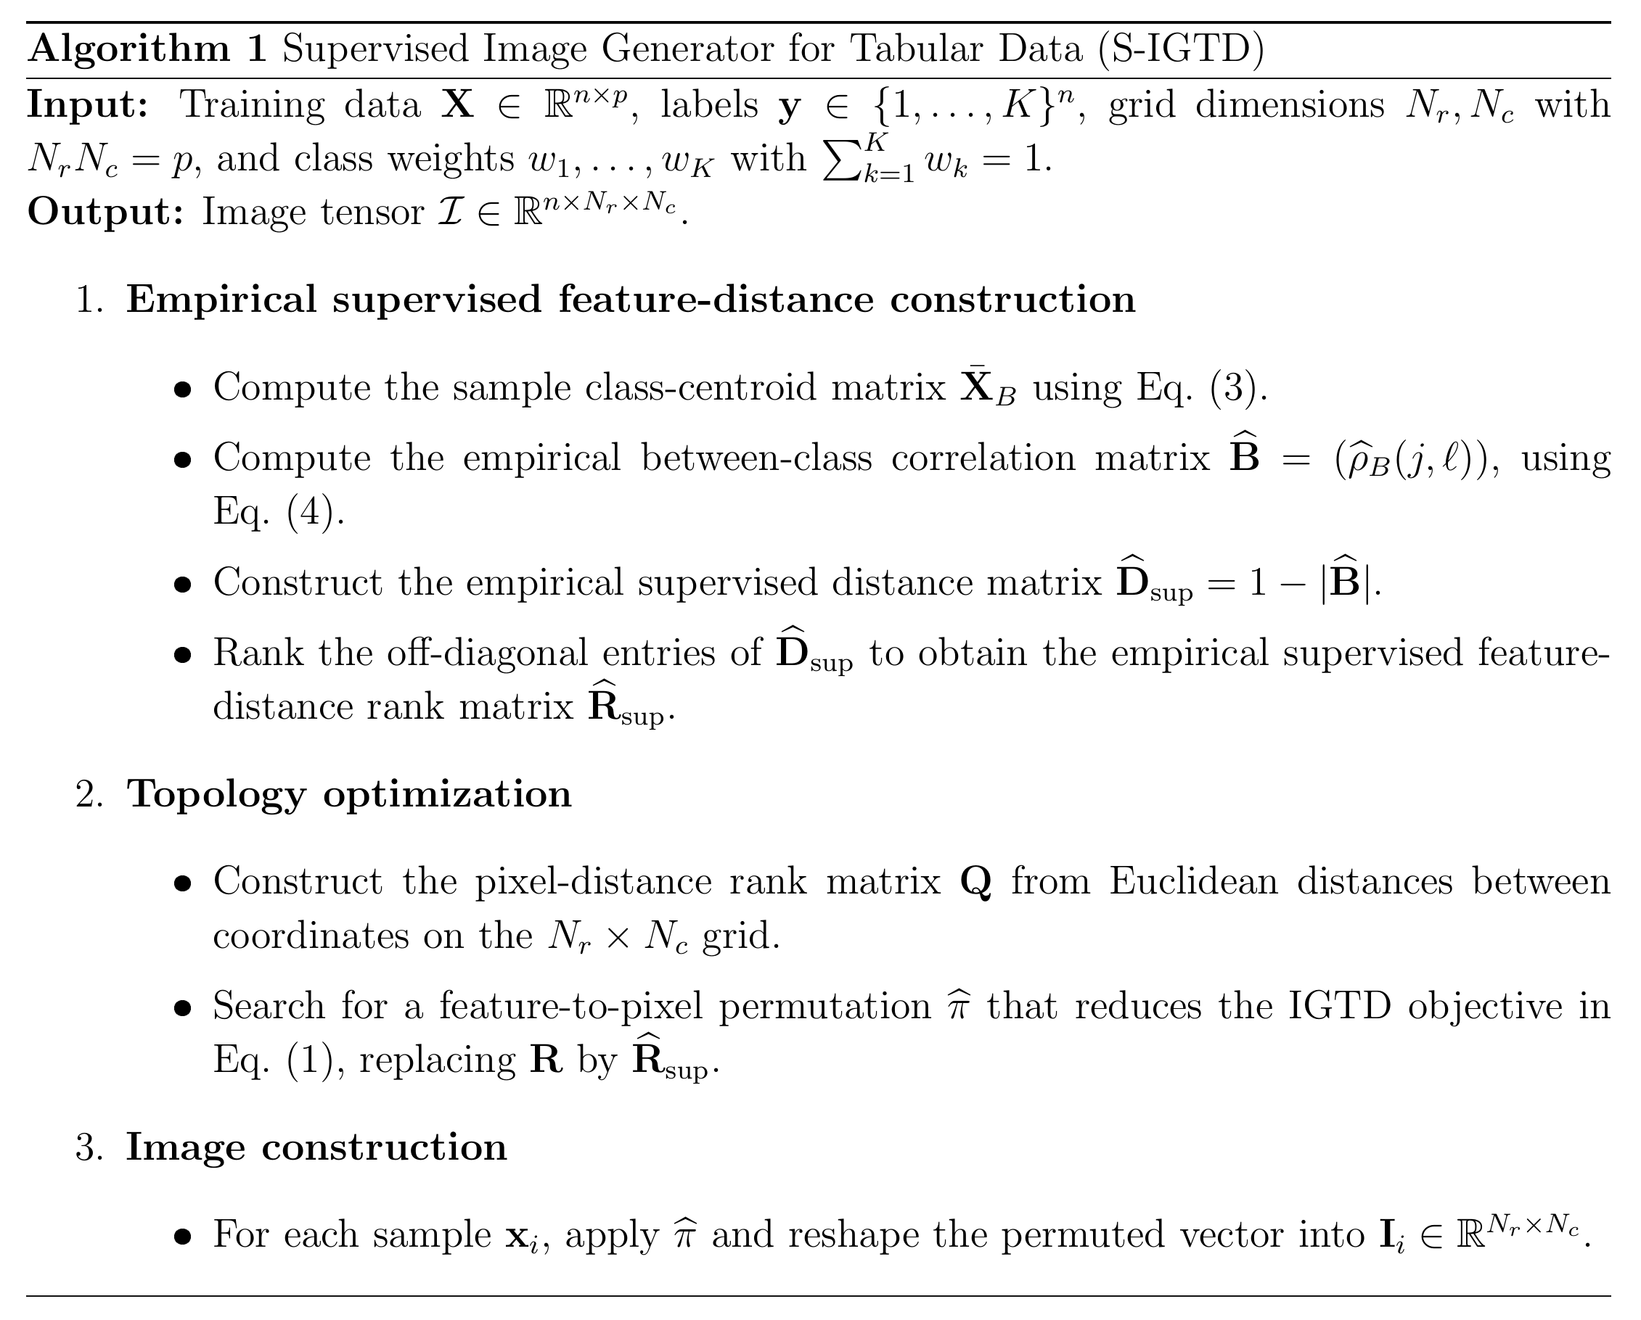
Supervised IGTD algorithm

Slide 26



Theoretical properties:
Asymptotic consistency
Weak Law of Large Numbers
Continuous Mapping Theorem
This discourages such features from being placed close to discriminative feature groups.

Slide 27

WABA decomposition and topological divergence
The practical interpretation is important in biological data.
In omics classification, a large total correlation ρ_{T} may arise from at least two different sources:
  coordinated class-level shifts that are useful for distinguishing disease, tissue or cell-type groups, or
  within-class covariation caused by housekeeping processes, metabolic background, batch effects or other nuisance structure.
S-IGTD is designed for the first source.

Slide 28



WABA decomposition and topological divergence (1)

Slide 29



WABA decomposition and topological divergence (2)

Slide 30



WABA decomposition and topological divergence (3)

Slide 31



WABA decomposition and topological divergence (4)

Slide 32
Goal of simulation studies
Balanced Labels and Feature Partition
Goal of simulation studies:
Four controlled simulation studies isolate the effect of replacing IGTD's unsupervised feature distance with the S-IGTD between-class WABA distance.
Primary endpoint: topology compactness of true signal features, measured by SDS.
Secondary diagnostics: test-set accuracy and macro-F1 from a Conv-BatchNorm-ReLU.
Balanced Labels and Feature Partition:
All simulation studies use K=6 balanced classes.
Class labels are fixed with exactly equal class sizes
The full feature set is split into true signal and nuisance features
The three signal blocks are disjoint and equal in size.

Slide 33



How Signal Features Are Generated

Slide 34


Class Profiles for Studies 1, 2 and 4

Slide 35



How Nuisance Features Are Generated

Slide 36




Heatmap: Generated n × p Data

Slide 37


CNN Structure In our Study
To ensure fairness in the comparison between methods, all CNN models adopted identical parameter settings.
Notes:
ReLU (Rectified Linear Unit「修正線性單元」)
電影《赤壁》中，諸葛亮說："什麼都略懂一點，生活才多彩一點。
諸葛亮說周瑜的陣過時了，周瑜問：「你也懂陣法？」他說：「略懂。」
諸葛亮要給馬接生。周瑜問:「這個你也懂？」他說:「略懂，略懂。」而後，為母馬接了生。
當周瑜問他是否懂琴，他也是說了句「略懂」。合琴中，琴聲如同有生命一般，讓人讚不絕口。
誠然，我們只有什麼都略懂一點，我們的人生才會更加豐富多彩，才能更好的應對生活的風浪。
原文網址：https://kknews.cc/essay/r3ejo84.html

Slide 38




Evalution metrics

Slide 39

Signal-feature layout maps
Signal-feature layout maps for the same representative Study~1/2/4 settings.
Bright pixels indicate true signal features.
S-IGTD may show two or more compact subregions because the simulator contains multiple signal blocks with different class-centroid profiles.

Slide 40


Simulation qualitative examples

Slide 41



Study 1: nuisance correlation

Slide 42



Study 2: sensitivity to sample size

Slide 43




Study 3: permutation test for label-dependent topology

Slide 44



Study 4: joint scaling of dimensionality and signal mass

Slide 45
Overall Simulation Interpretation
Simulations support the topology-focused claim.
Signal-feature neighborhoods remain compact under nuisance correlation, finite samples, and large p.
Accuracy and macro-F1 improve on average.
(Classifier performance is secondary, not a general superiority claim.)

Slide 46



Real-data benchmark: datasets and preprocessing
Each dataset uses 10 stratified 80/20 training-test replications with matched random seeds across methods.

Slide 47


Real-data protocol and comparators

Slide 48
Real-data SDS proxy and statistical testing
Ground-truth signal features are unknown in real biological data.
Real-data SDS is computed against a proxy: top 12 percent of features by training-set ANOVA F-statistic, bounded between 20 and 300 features.
SDS is interpreted as agreement with a supervised univariate topology proxy, not as direct biological signal recovery.
Testing uses paired Wilcoxon signed-rank tests over 10 matched replications; alternatives are less for SDS and greater for accuracy/macro-F1.
Holm-Bonferroni correction is applied within each dataset and metric family.

Slide 49

Topology compactness: headline SDS results

Slide 50

Classifier compatibility under Conv-BN-ReLU

Slide 51

Concluding Remarks
S-IGTD replaces IGTD's unsupervised feature-distance metric with $d_{sup}=1−|ρ_{B}|$ on the class-centroid matrix.
The contribution is pairwise supervised topology learning.
Theory establishes entrywise consistency of the supervised distance and identifies WABA settings where supervised topology is more appropriate than total-correlation topology.
Empirically, S-IGTD produces compact supervised layouts in controlled simulations and biological benchmarks.
Accuracy is compatible but secondary; corrected tests do not support a universal accuracy-superiority claim.

Slide 52
Limitations, when to use, and future work
Limitations: Quadratic Assignment Problem (QAP) runtime, linear centroid correlation, rectangular grid constraints, empirical binary extension, and real-data SDS based on an ANOVA-F proxy.
When to use: Use S-IGTD when the analysis target is a class-supervised image layout, especially multiclass omics with informative class-centroid covariation.
Pseudo-images can be analyzed by CNNs or other spatial-neighborhood, texture, or local aggregation methods.
Projection-based methods remain appropriate when global feature geometry is the main object of interest.
Future work: IGTD for categorical tabular data. S-IGTD for time series classification, regression S-IGTD, classifier-aware topology, signed between-group correlation,

Slide 53



Acknowledgments
wuhm@g.nccu.edu.tw
https://hmwu.idv.tw
- National Science and Technology Council, Taiwan.
(113-2813-C-004 -005 -M)
- National Chengchi University, Taiwan
- Institute of Statistical Science, Academia Sinica , Taiwan
Thanks for
Listening!
https://infostat.nccu.edu.tw/csa2026
https://infostat.nccu.edu.tw/csa2026
Notes:
電影《赤壁》中，諸葛亮說："什麼都略懂一點，生活才多彩一點。
諸葛亮說周瑜的陣過時了，周瑜問：「你也懂陣法？」他說：「略懂。」
諸葛亮要給馬接生。周瑜問:「這個你也懂？」他說:「略懂，略懂。」而後，為母馬接了生。
當周瑜問他是否懂琴，他也是說了句「略懂」。合琴中，琴聲如同有生命一般，讓人讚不絕口。
誠然，我們只有什麼都略懂一點，我們的人生才會更加豐富多彩，才能更好的應對生活的風浪。
原文網址：https://kknews.cc/essay/r3ejo84.html

