Slide 1
LSVT companion
speech rehabilitative treatment

Slide 2
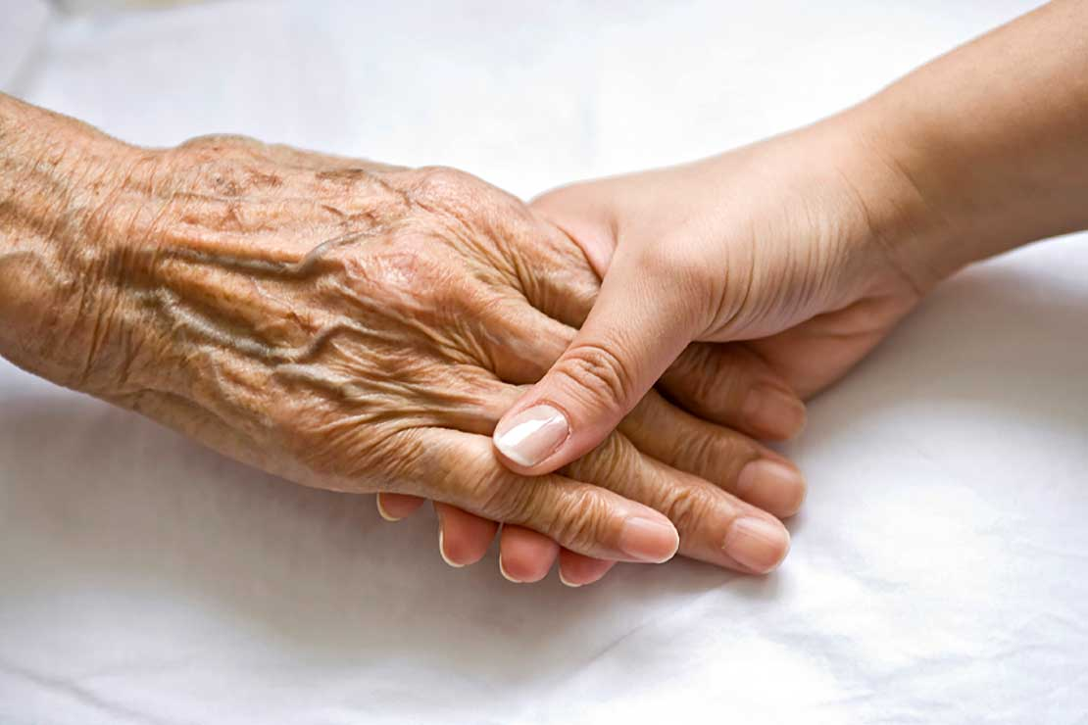
帕金森氏症
parkinson's disease

Slide 3
LSVT-LOUD
Lee Silverman Voice Treatment
病症出現
harsh vocal quality
療程
加大音量
重新適應
習慣音量
reduce stress
Monoloudness
imprecise consonants
加大音調變化
誇張的發音
單音、詞、短句、短文
肌肉發力
維持言語功能
減緩退化
傳統療程
Notes:
音質嘶嘎聲(harsh vocal quality)、重音不足(reduce stress)、音量變化不足、(monoloudness)與聲母構音不清晰(imprecise consonants)

Slide 4
Potential problem
urgent need of solution
issue
Clinicians insufficiency
Sustained treatment is required
lacking of treatment accessibility

Slide 5
LSVT Companion
Auto-diagnosis system
automatically collecting and analyzing voice data
Support practice at home
increase accessibility by home edition

Slide 6
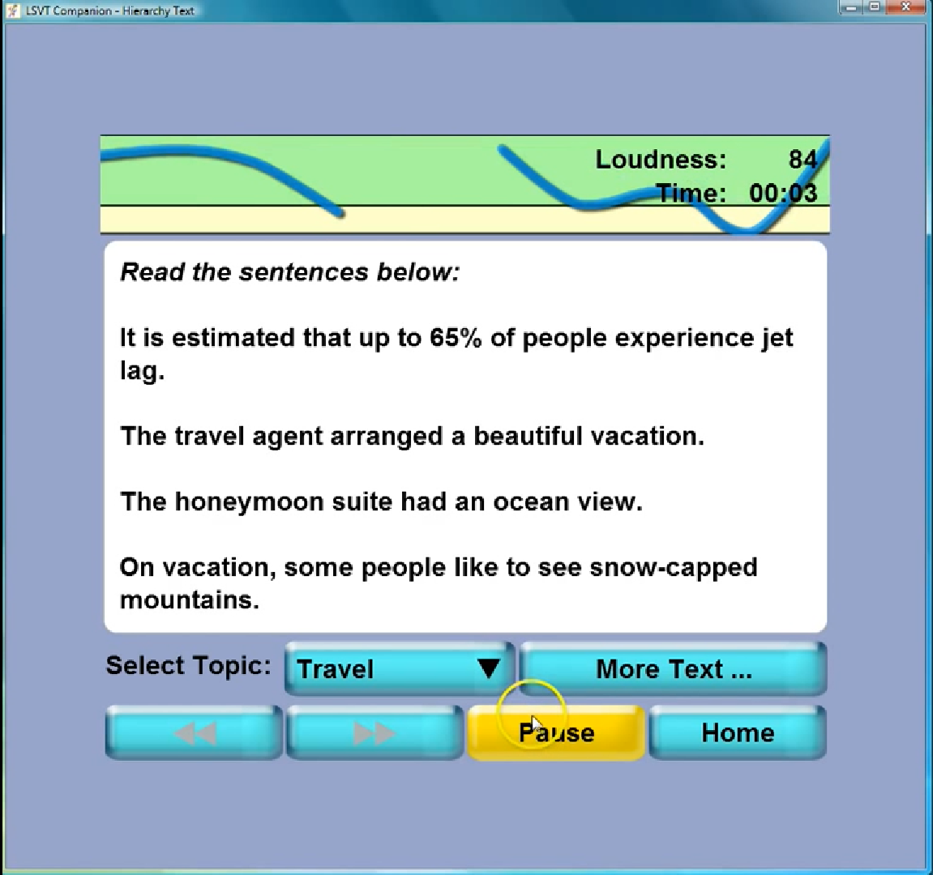

Slide 7
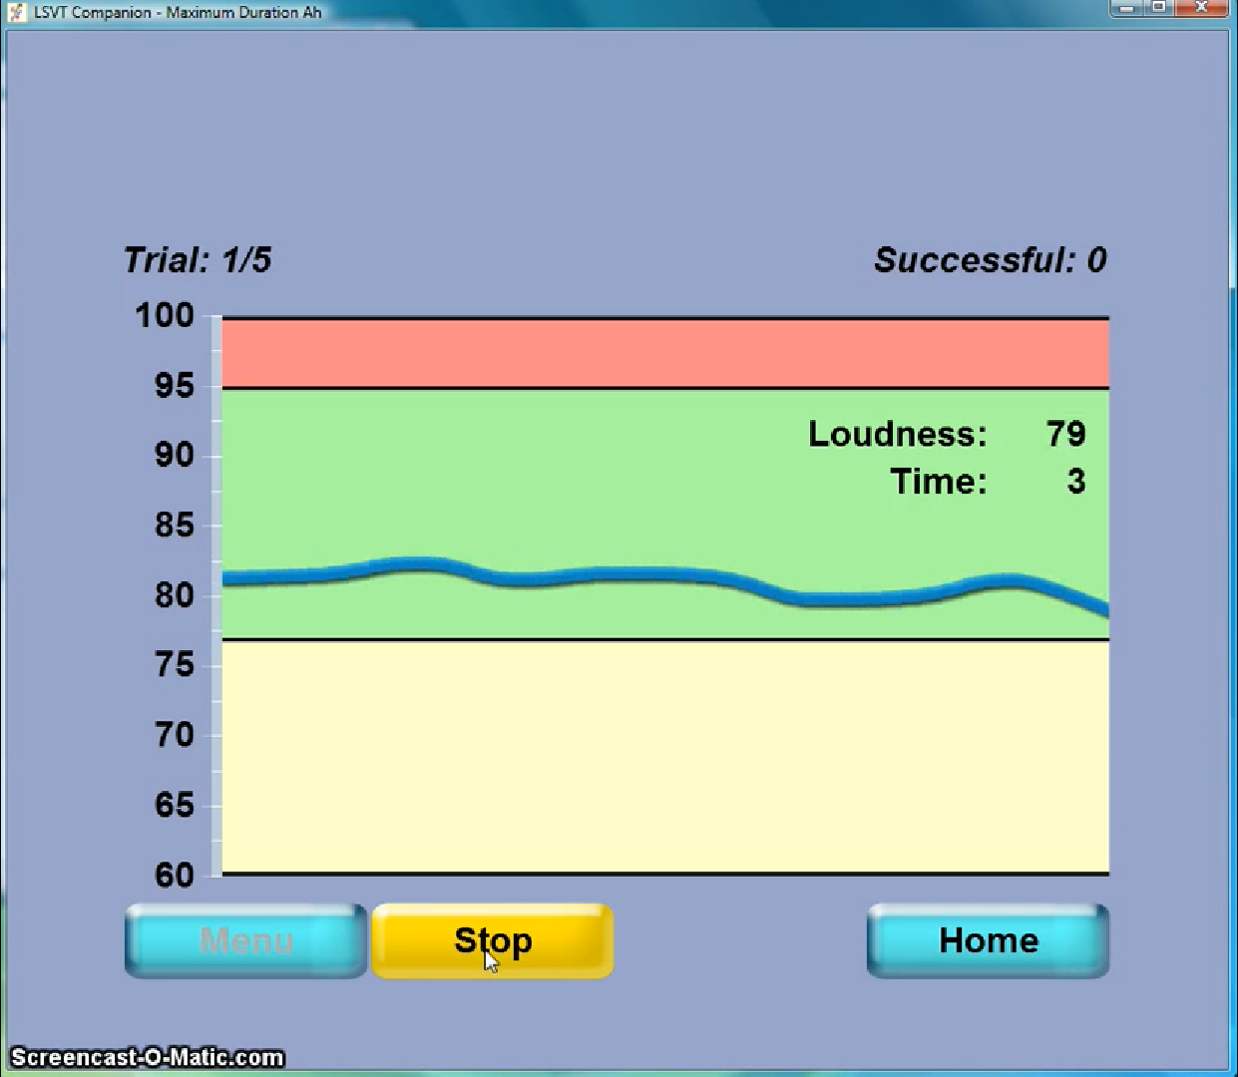

Slide 8
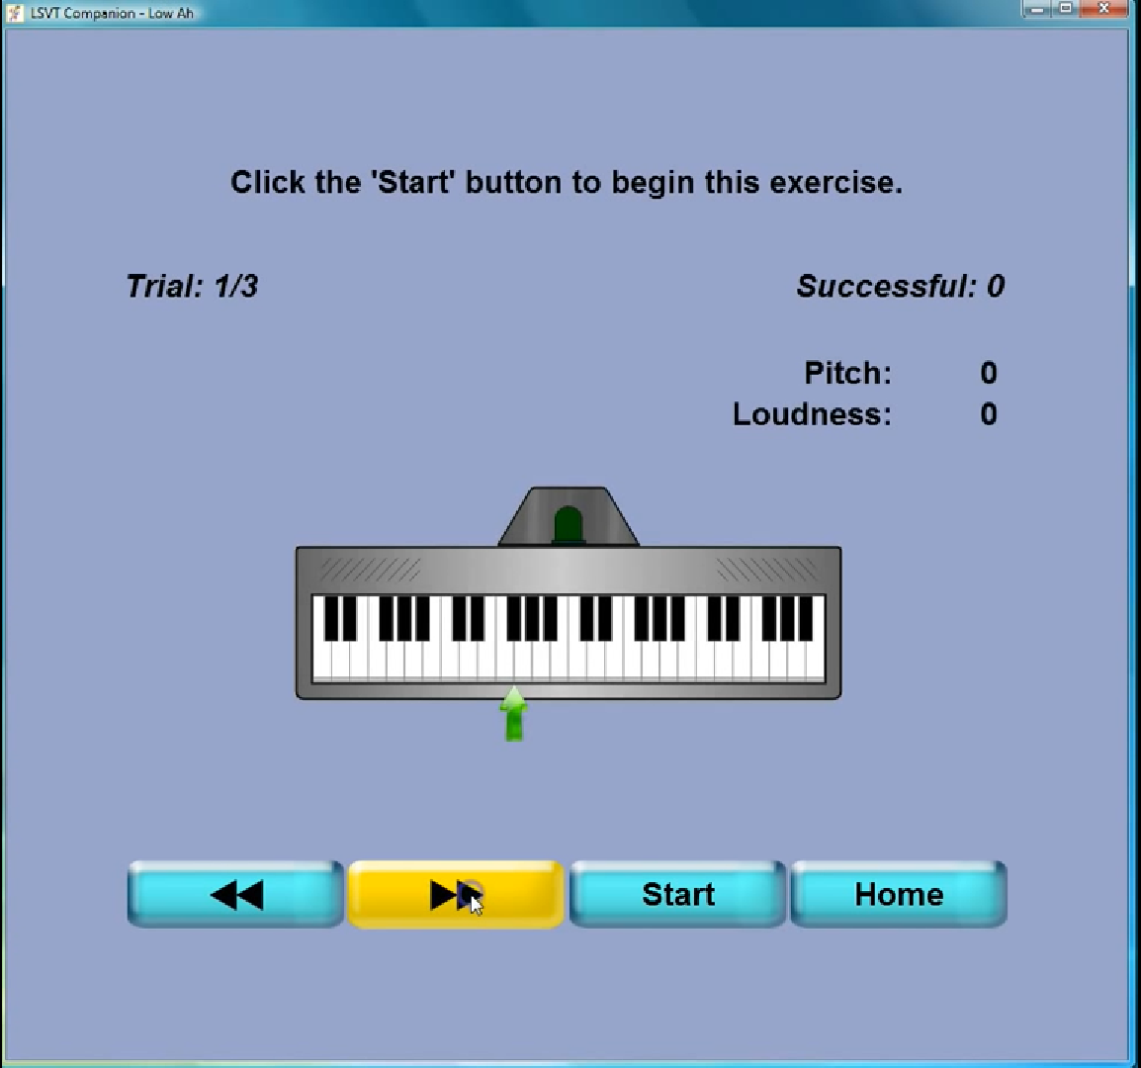

Slide 9
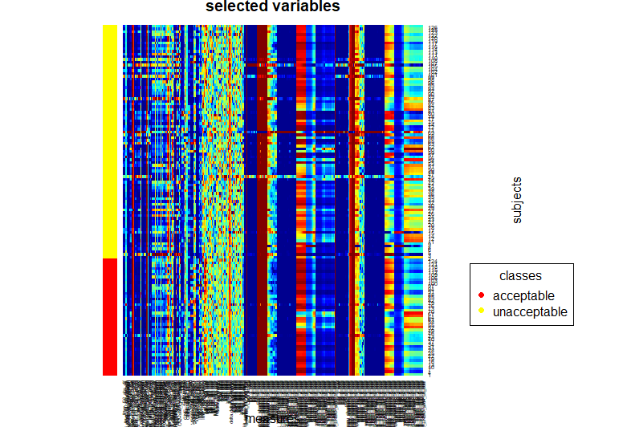
探索性資料分析
細項不列
無遺失值問題
heatmap

Slide 10
Find top 10 informative variables
goal
Objective automatic assessment of rehabilitative speech treatment in Parkinson’s disease
Athanasios Tsanas, Max A. Little, Cynthia Fox, Lorraine O. Ramig

Slide 11
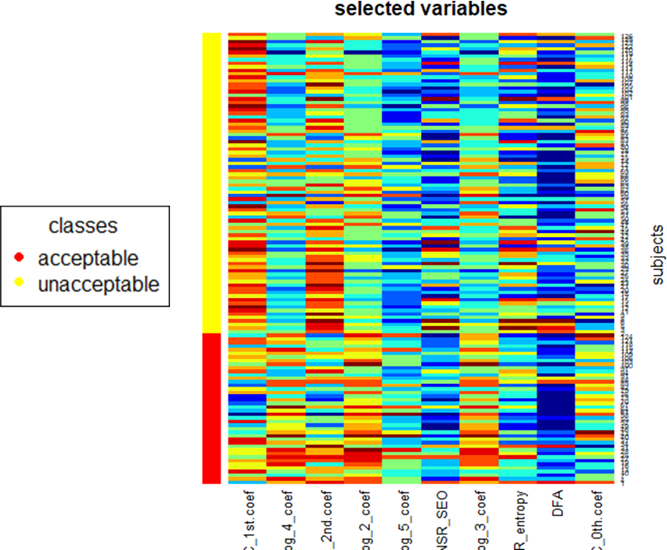
Find top 10 informative variables
bw-ratio

Slide 12
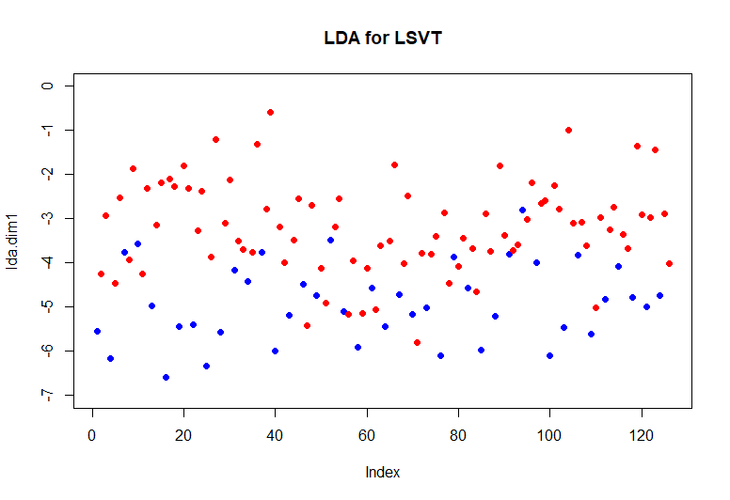
LDA

Slide 13
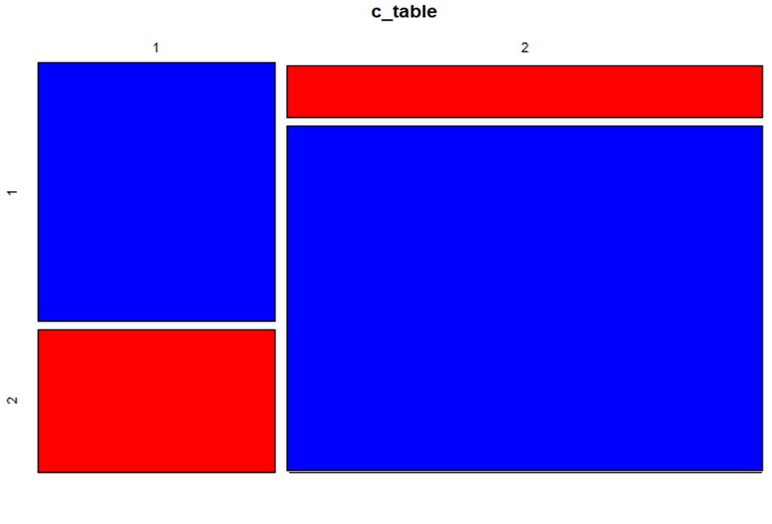
LDA
15
27
73
80％ accuracy
11

Slide 14
資料中為「unacceptable」的資料佔了$2/3$
smote

Slide 15
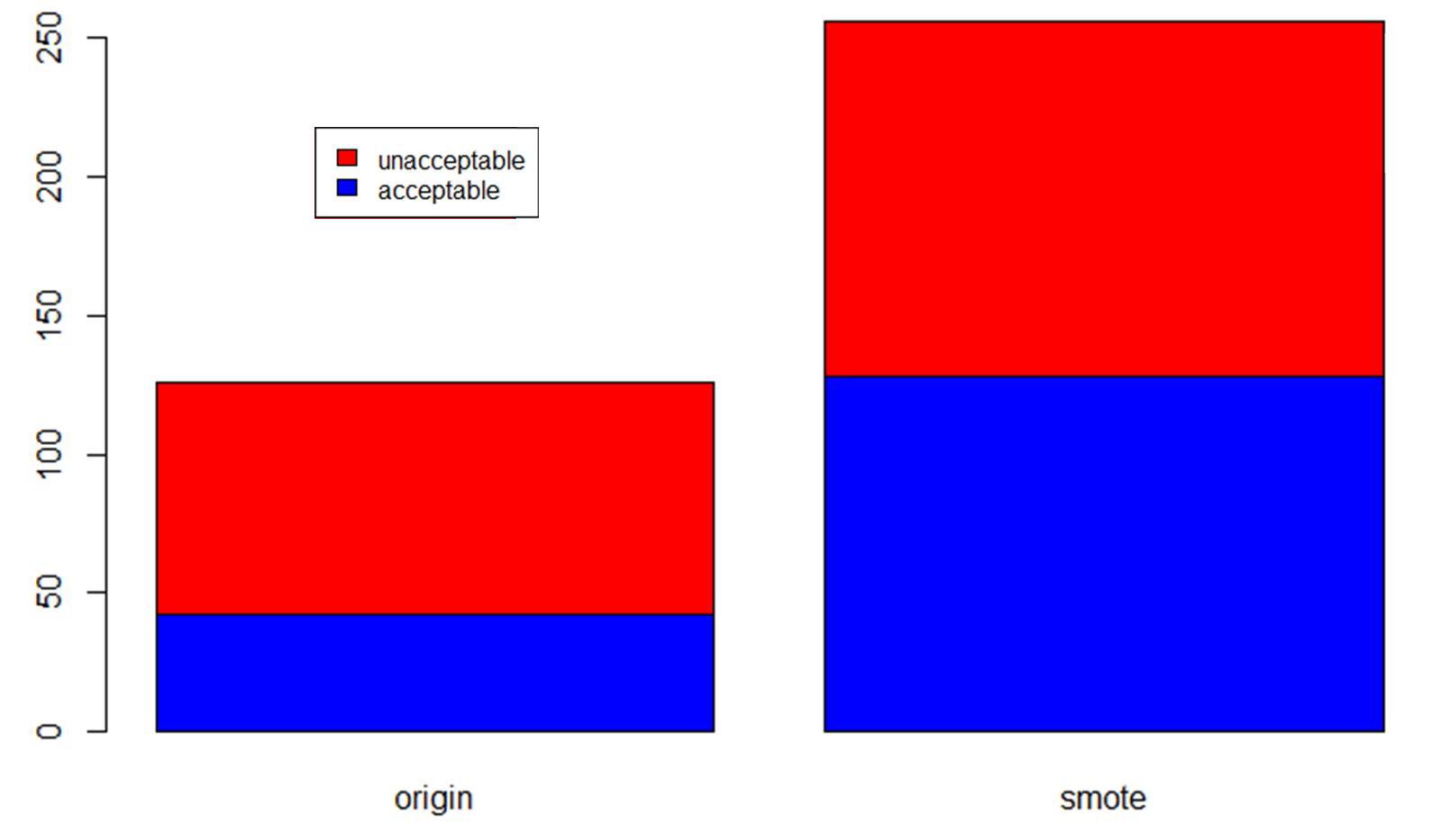
unbalanced

Slide 16
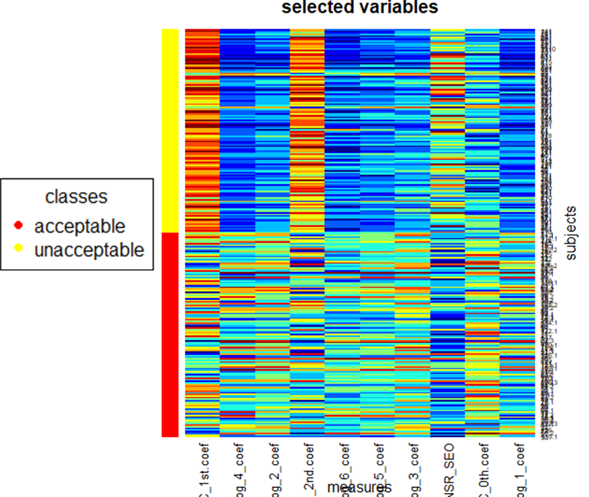
Find top 10 informative variables

Slide 18
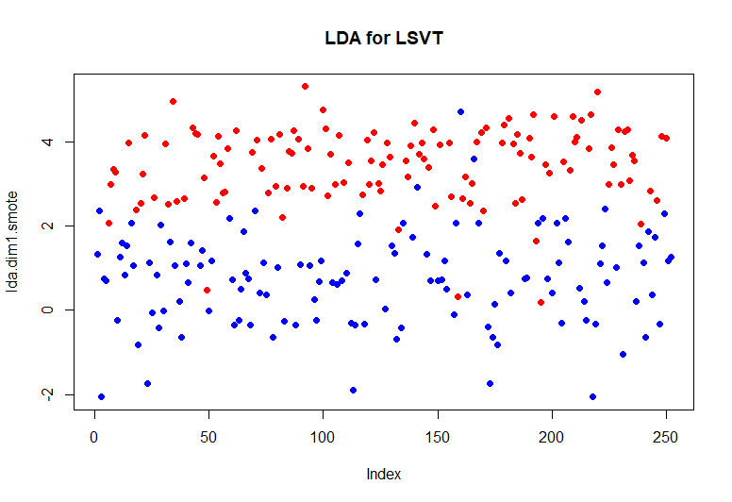
LDA

Slide 19
origin
smote

Slide 20
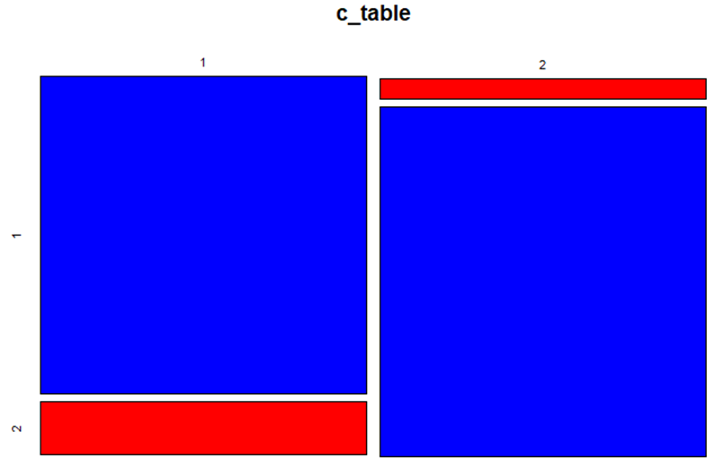
LDA
18
108
119
90％ accuracy
7

Slide 21
conclusion

